Slide 1
The Soluble Guanylate Cyclase Stimulator Vericiguat in Worsening Chronic Heart Failure with Reduced Ejection Fraction: The SOCRATES-REDUCED Dose Finding Phase II Study
Mihai Gheorghiade MD
Center for Cardiovascular Innovation, Northwestern University Feinberg School of Medicine, Chicago, Illinois
On behalf of: Stephen J Greene MD; Javed Butler MD MPH MBA; Gerasimos Filippatos MD; Carolyn SP Lam MBBS; Aldo P Maggioni MD; Piotr Ponikowski MD; Sanjiv J Shah MD; Scott D Solomon MD; Elisabeth Kraigher-Krainer MD; Eliana T Samano MD; Katharina Müller Dipl Stat; Lothar Roessig MD; Burkert Pieske MD; for the SOCRATES-REDUCED Trial Investigators and Coordinators
Notes:
Slide #1 (Introduction): Dear colleagues, today I am pleased to present to you the results of the Phase IIb SOCRATES-REDUCED study on behalf of the SC, the Investigators, and study coordinators.

Slide 2
Study Organization
Steering Committee
Javed Butler
Gerasimos Filippatos
Mihai Gheorghiade (Co-chair)
Carolyn Lam
Aldo Maggioni
Burkert Pieske (Co-chair)
Piotr Ponikowski
Sanjiv Shah
Scott Solomon
DSMB
John McMurray (Chair)
Christopher Granger
Wilhelm Haverkamp
Paul Armstrong (previous chair)
Clinical Event Committee
Gerasimos Filippatos (Chair)
Aldo Maggioni
Piotr Ponikowski
Notes:
Here are the members of the SC, DSMB and clinical event committees. The SOCRATES-REDUCED trial was funded by Bayer in collaboration with Merck

Slide 3
Study Background
There are >1 million hospitalizations with a primary diagnosis of heart failure (HF) annually in the United States, alone. ¹
>80% of hospitalized HF patients have worsening chronic HF. In spite of available therapies their post discharge mortality and rehospitalization rate can be as high as 15% and 35% respectively within 60 days post discharge. ¹
The nitric-oxide (NO) - soluble guanylate cyclase (sGC) - cyclic guanosine monophosphate (cGMP) pathway is a potential therapeutic target for the treatment of HF. ²
sGC stimulators offer a novel approach to increase cGMP-generation by sGC in a NO-independent manner.²
Vericiguat is a once daily oral sGC stimulator being developed in HFrEF (SOCRATES-REDUCED) and HFpEF (SOCRATES-PRESERVED)
1, Gheorghiade et al. JACC 2013;61.391-403
2, Gheorghiade et al. Heart Fail Rev 2013;18:123-134
Notes:
There are millions of people with worsening HF despite many evidence based therapies. Only a minority have end stage HF as attested by BP and diuretics.
These patients still have unacceptably high post-discharge event rates which has not changed in 10 years . Approximately 25% or patients are re-hospitalized within 30 days and 30% die within one year.
To the best of my knowledge, this unacceptably high event rate has not changed in the past decade !! There is clearly an unmet medical need to develop additional drugs / devices in this patient population.
Cyclic nucleotide cyclic guanosine 3’, 5 monophosphate (cGMP) is a key second messenger that regulates many cell, tissue, and body functions . It appears to be critical for cardiac and microvascular performance, mitochondrial energetics, and endothelial function . Importantly, cGMP synthesis is decreased in heart failure and is correlated with worse outcomes.
Vericiguat is a once daily sGC stimulator that acts independently of nitric oxide, restoring downstream cGMP
Signaling.
It has demonstrated a favorable safety profile in Phase I studies

Slide 4
Study Objectives
Primary objective: Determine the vericiguat dose for a Phase III study in addition to standard therapy in patients with worsening chronic HFrEF
by characterizing tolerability, pharmacodynamic effects, and pharmacokinetics, and
detecting a significant dose-response relationship in NT-ProBNP change at 12 weeks
Exploratory Endpoints:
Clinical outcomes, including CV death and HF hospitalization
Echocardiography parameters, including LVEF, LVEDV, LVESV
CV: cardiovascular. HF: heart failure, LVEF, left ventricular ejection fraction;
LVEDV: left ventricular end-diastolic volume; LVESV: left ventricular end-systolic volume
Notes:
The objective of the Phase II SOCRATES study was to determine the optimal dose of vericiguat in addition to standard of care in patients with worsening HFrEF by characterizing its tolerability and detecting a dose-response relationship in NTpro-BNP. Additional exploratory endpoints included clinical outcomes and echocardiography parameters.

Slide 5
Select Eligibility Criteria
Inclusion Criteria
Exclusion Criteria
NYHA Class II-IV with LVEF ≤45% on standard of care HF therapy with an episode of worsening HF defined by:
Worsening symptoms requiring either a hospitalization OR outpatient IV diuretics
NT-proBNP ≥1000 or BNP ≥300 if in NSR; NT-proBNP ≥1600 or BNP ≥500 if in AF
Signs / symptoms of congestion
IV inotropes at any time between hospitalization and randomization
Nitrate use
Significant valvular, infiltrative, or pericardial disease
Listing for heart transplant or LVAD
eGFR <30ml/min/1.73m²
AF, atrial fibrillation; eGFR, estimated glomerular filtration rate; HF, heart failure; LVAD, left ventricular assist device; LVEF, left ventricular ejection fraction; NYHA, New York Heart Association Class; NSR, normal sinus rhythm;
Notes:
Patients with NYHA Class II-IV, LVEF < 45% receiving guideline-directed HF therapy and a recent episode of worsening heart failure defined as worsening HF requiring hospitalization or outpatient IV diuretics, with signs of congestion AND high natriuretic peptide levels were eligible for the study.
Exclusion criteria are shown here
Patients required to be clinically stable, prior to randomization, defined as:
No IV vasodialtor therapy for at least 24 hours and no IV diuretic for at least 12
SBP > 110 and < 160
And, HR > 50 and < 100

Slide 6
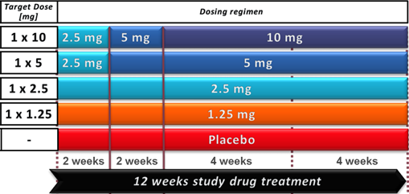
Study Design Five-arm dose-finding phase 2 study
Clinically stable inpatients and outpatients randomized within 4 weeks of informed consent to 1 of 5 treatment groups
Titration based on SBP:
≥100 mmHg: double dose
90 to <100 mmHg: maintain dose
<90 mmHg without symptoms: half the dose
‡
4 weeks
FU
V1
V2
V3
V4
V5
FU
FU, follow up; ‡ after 8 weeks (visit 4), 71.8% patients were on 10 mg and 15.4% were on 5 mg
Notes:
Disposition of patients that reached target dos: After 8 weeks follow up (visit 4), 71.8% patients were on 10 mg and 15.4 % were on 5 mg
Important to again re-emphasize here that patients could be enrolled both as inpatients and outpatients.
Note: if asked., at 8 weeks of follow up (visit 4), 71.8% patients were on 10 mg and 15.4 % were on 5 mg

Slide 7
Statistical Analysis
Primary Endpoint: change in log-transformed NT-proBNP from baseline to week 12
Primary Analysis tested for a significant difference in the primary endpoint of the pooled three highest dose arms compared with placebo.
A one-sided t-test with 5% significance-level was performed.
Secondary Analyses
Pairwise comparisons of individual dose groups with placebo were planned in a hierarchical manner (from highest to lowest dose group).
Each test was one-sided with a significance level of 5%.
Formally, the tests are confirmatory only if the primary analysis is significant.
Notes:
The primary endpoint of the study was change in natriuretic biomarkers from baseline to 12 weeks. All additional endpoints were exploratory or related to safety.
For the pre-specified primary analysis of the primary endpoint, the 3 highest dose vericiguat groups were pooled and compared to placebo. Secondary analyses of the primary endpoint were pre-specified to investigate a dose response relationship of the individual across the studied vericiguat dose as well as the individual dose groups

Slide 8
Patient Disposition
176 Patients Excluded
137 did not meet eligibility criteria
33 withdrawal by patient
1 AE
1 Death
1 Lost to F/U
1 PI decision
2 protocol violations
632 Patients Screened
456 Randomized
PBO
n=91
1.25 mg
n=91
2.5 mg
n=91
2.5 to 5 mg
n=91
2.5 to 10 mg
n=91
362 Completed Treatment
PBO
n=73
1.25 mg
n=70
2.5 mg
n=76
2.5 to 5 mg
n=69
2.5 to 10 mg
n=74
351 Per-Protocol Set
PBO
n=69
1.25 mg
n=69
2.5 mg
n=73
2.5 to 5 mg
n=67
2.5 to 10 mg
n=73
Notes:
Of 632 patients screened, 456 were randomized into 5 equally sized study groups (4 vericiguat groups, 1 placebo group. Approximately 80% of patients completed the study. The mean time from clinical stabilization to randomization was 14.4 days. Overall, 351 patients (77%) had completed the study with valid biomarker levels and were included in the per-protocol set (PPS) for validation of the primary end point.

Slide 9
Global Study Participation
Patients screened and randomized at 160 study centers across 24 countries
N. America 6%
Europe
W. Europe 51%
E. Europe 25%
Asia Pacific 18%
Notes:
Global representation of study recruitment is depicted here. . 160 sites in 24 countries participated in the study. The majority of patients came from Europe, with 51% from Western Europe and 25% from Eastern Europe. Asia Pacific contributed 18% and N. America 6%.

Slide 10
Baseline Characteristics
Distribution of demographic data and baseline characteristics were similar amongst groups
Higher median baseline NT-proBNP levels in the placebo and 1.25 mg arms
Background therapy: >90% ß-blocker, >84% ACE-I/ARB, MRA >62%, >27% ICD
 | Placebo N=92 | 1.25 mg N=91 | 2.5 mg N=91 | 2.5 to 5 mg N=91 | 2.5 to 10 mg N=91
Age (years, mean) | 67 | 68 | 67 | 67 | 69
NT-proBNP (pg/mL, mean/median) | 5692/ 4043 | 7096/ 3670 | 5243/ 2721 | 3404/ 2644 | 5869/ 2805
Hospitalization/IV diuretic for HF (%) | 77/23 | 79/21 | 84/17 | 75/25 | 75/25
NYHA III,IV (%) | 41 | 52 | 48 | 52 | 44
LVEF (%, mean) | 28.6 | 29.5 | 29.2 | 31.5 | 29.3
Systolic blood pressure (mmHg,) | 124 | 126 | 125 | 125 | 128
Atrial fibrillation (%) | 33 | 35 | 33 | 33 | 35
CAD etiology (%) | 55 | 51 | 63 | 46 | 51
Diabetes mellitus (%) | 45 | 40 | 59 | 43 | 54
Chronic kidney disease (%) | 41 | 39 | 45 | 41 | 39
Hypertension (%) | 76 | 78 | 77 | 75 | 86
Notes:
Baseline characteristics were well balanced between study groups, with exception of higher median NT-proBNP levels in the placebo and 1.25 mg vericiguat groups. The majority patients fulfilled worsening heart failure criteria by being hospitalized versus those randomized after requiring outpatient IV diuretics (78% vs 22%). Approximately half of the patients had ischemic etiologies

Slide 11
Primary Endpoint
Change in NT-proBNP at 12 weeks (per protocol analysis)
Primary endpoint
Primary analysis: NT-proBNP reduction in pooled 2.5/5/10 mg dose groups > reduction in placebo (NS, p=0.1506)
Secondary analyses: Dose-response relationship in primary endpoint NT-proBNP (p=0.0174, exploratory only)
NT-proBNP reduction in 10 mg group > placebo (p=0.0483; pre-specified pairwise comparison, exploratory only)
-24.5%
-23.3%
-27.4%
-29.8%
-41.0%
-33.1%
p=0.048
p=0.15
% change from baseline
Notes:
In the primary analysis of the primary endpoint, change in NT-proBNP from baseline to week 12 was not significantly different between the pooled vericiguat group and placebo.
In the pre-specified secondary analysis, a significant dose-response relationship was observed and the 10 mg vericiguat arm showed greater reductions greater reductions in NT-proBNP than placebo (40% decrease from baseline) at 12 weeks (p<0.05)

Slide 12
No Clinical Adverse Effects on Blood Pressure, Heart Rate, Renal Function or Troponin
GFR, glomerular filtration rate
10 mg: 2.5 to 10 mg arm
mean ± standard deviation (SD)
Notes:
As titrated in this study, vericiguat was not associated with any deleterious effects on heart rate or blood pressure. . Changes in mean SBP, DBP and HR from baseline were similar between the placebo and 10 mg vericiguat arms. There were no adverse effects on troponin release or GFR

Slide 13
Echocardiography: LVEF
P<0.05
Full analysis set
mean ± standard deviation (SD)
Parameter | Placebo |  | 1.25 mg |  | 2.5 mg |  | 2.5 to 5 mg |  | 2.5 to 10 mg
 | Baseline | Change at wk 12 | Baseline | Change at wk 12 | Baseline | Change at wk 12 | Baseline | Change at wk 12 | Baseline | Change at wk 12
LVEF (%) | 28.6 | + 1.5 | 29.5 | + 2.8 | 29.2 | + 2.7 | 31.5 | + 2.1 | 29.3 | + 3.7
LVEDV (mL) | 174 | - 7 | 173 | -6 | 174 | -10 | 177 | -17 | 161 | -7
LVESV,(mL) | 127 | - 7 | 125 | -9 | 126 | -11 | 125 | -15 | 120 | -11
LVEF, left ventricular ejection fraction; LVEDV: left ventricular end-diastolic volume; LVESV: left ventricular end-systolic volume
mean values
Notes:
Here are the changes in echo parameters. Patients randomized to the 10 mg vericiguat arm demonstrated an increase in LVEF compared to placebo, which would be a very early timepoint to expect that. At 12 weeks, there were no significant differences in LVEDV or LVESV between placebo and any vericiguat group

Slide 14
Exploratory clinical events
Time to composite of HF hospitalization and CV death
Treatment Group |  | HR¹ (95% CI)
--------- | Placebo
--------- | 1.25 mg | 0.97 (0.50-1.88)
--------- | 2.5 mg | 1.01 (0.52-1.94)
--------- | 2.5 to 5 mg | 0.63 (0.30-1.34)
--------- | 2.5 to 10 mg | 0.53 (0.25-1.16)
Pooled (2.5/5/10 mg) |  | 0.72 (0.41-1.26)
Observation period | Number of subjects with clinical event | Placebo (N=92) | 1.25 mg (N=91) | 2.5 mg (N=91) | 2.5 to 5 mg (N=91) | 2.5 to 10 mg (N=91)
Until week 12 | CV death or HF hospitalization | 18 (19.6%) | 17 (18.7%) | 18 (19.8%) | 11 (12.1%) | 10 (11.0%)
End of F/U | Death (all-cause) | 6 (6.5%) | 6 (6.6%) | 5 (5.5%) | 3 (3.3%) | 4 (4.4%)
Hazard Ratio (HR) and CI derived from Cox Proportional Hazard model. Hazard ratio and CIs are calculated, if minimum number of 5 events in total and 1 event in each treatment arm exist. Hospitalization and deaths are adjudicated by an independent adjudication committee and classified as CV or non-CV. ¹ Vericiguat/ Placebo. FAS, full analysis set

Slide 15
Adverse Events
 | Placebo (n=92) | 1.25 mg (n=91) | 2.5 mg (n=90) | 2.5 to 5 mg (n=91) | 2.5 to 10 mg (n=91)
Any AE | 71 (77.2) | 64 (70.3) | 71 (78.9) | 67 (73.6) | 65 (71.4)
Any study drug related AE | 13 (14.1) | 10 (11.0) | 13 (14.4) | 12 (13.2) | 15 (16.5)
AE with outcome death | 5 (5.4) | 6 (6.6) | 4 (4.4) | 2 (2.2) | 4 (4.4)
Any SAE | 36 (39.1) | 31 (34.1) | 35 (38.9) | 24 (26.4) | 29 (31.9)
Any study drug-related SAE | 3 (3.3) | 1 (1.1) | 1 (1.1) | 1 (1.1) | 4 (4.4)
D/C of study drug due to AE | 7 (7.6) | 10 (11.0) | 9 (10.0) | 8 (8.8) | 8 (8.8)
D/C of study drug to SAE | 5 (5.4) | 6 (6.6) | 2 (2.2) | 5 (5.5) | 7 (7.7)
TEAE, Hypotension | 6 (6.5) | 5 (5.5) | 6 (6.7) | 4 (4.4) | 14 (15.4)‡
Asymptomatic | 1 (1.1) | 2 (2.2) | 3 (3.3) | 2 (2.2) | 5 (5.5)
Symptomatic | 5 (5.4) | 3 (3.3) | 3 (3.3) | 2 (2.2) | 10 (11.0)
TEAE, Syncope | 1 (1.1) | 0 | 2 (2.2) | 1 (1.1) | 4 (4.4)
Acute kidney injury | 3 (3.3) | 5 (5.5) | 2 (2.2) | 1 (1.1) | 3 (3.3)
AE, adverse event; D/C, discontinue TEAE, treatment-emergent AE ; SAE, serious adverse event;
‡ 8 patients had hypotension in first 2 weeks (2.5 mg dose) and 2 patients in weeks 2-4 (max dose 5 mg)
one patient had both, symptomatic and asymptomatic hypotension. Safety analysis set.
Notes:
Additional exploratory endpoints are represented here. Numerically fewer patients in the 5 mg (11 patients) and 10 mg vericiguat groups (10 patients) experienced the composite of cardiovascular death or HF hospitalization compared to placebo (18 patients). At the end of follow up (16 weeks), all cause mortality occurred at a rate of 6.5% in the placebo group vs. 4.4% in patients randomized to 10 mg vericiguat

Slide 16
Conclusions
The primary analysis of the primary endpoint of this dose finding phase II study was not met.
In pre-specified secondary analysis, we observed a dose-related effect on the primary endpoint change in NT-proBNP.
Pre-specified exploratory analysis suggested that, compared to placebo, the 10mg dose decreases NT-proBNP.
As titrated in this study, vericiguat was not associated with any deleterious effects on heart rate, blood pressure, renal function, or troponin release.
Reduction in NT-proBNP in the highest dose arm was associated with improved LVEF and trends toward fewer clinical events at 12 weeks.
Based on these results, a large Phase III study is warranted.
Notes:
We found a dose-response in NT-proBNP that goes in line with LV function, symptoms improvement and clinical outcomes without adverse effect on blood pressure, heart rate, cardiac injury and kidney function

Slide 17
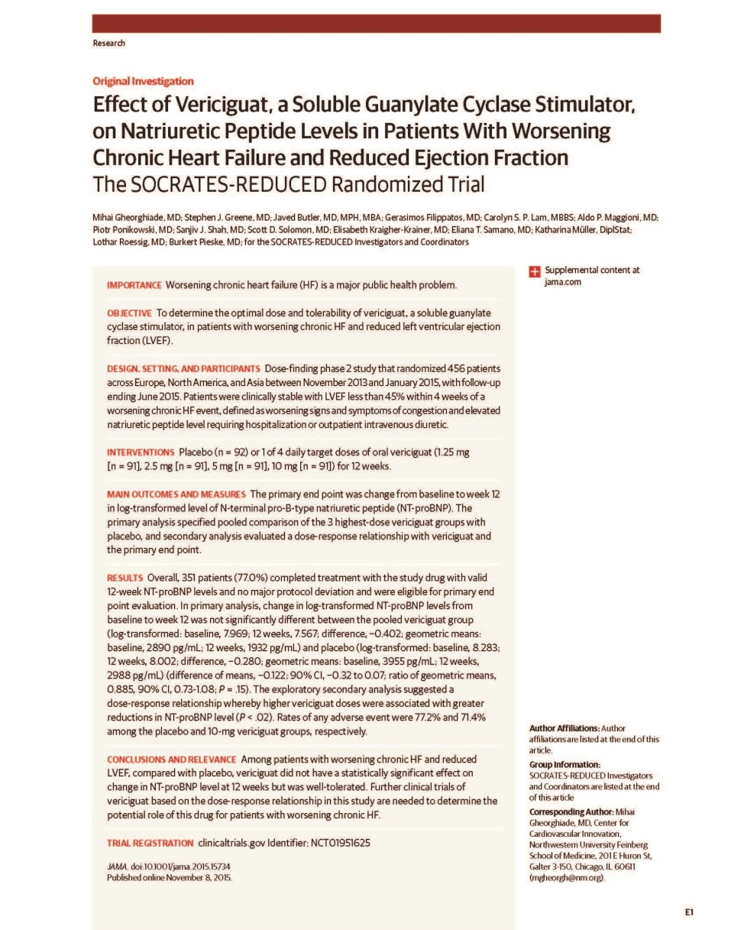
Mihai Gheorghiade and coauthors
Effect of Vericiguat, a Soluble Guanylate Cyclase Stimulator, on Natriuretic Peptide Levels in Patients With Worsening Chronic Heart Failure and Reduced Ejection Fraction:
The SOCRATES-REDUCED Randomized Trial
Published online November 8, 2015

